Slide 1

How to identify your strengths and weaknesses
Introduction
First create two list
Before you use any outside sources to help identify your strengths and weaknesses , I recommend that you spend about 30 minutes alone creating two lists , Your first list is going to be called Centered on my Business or Entrepreneurship Goals . Call it something like “Skills Needed to Succeed” .

Slide 2
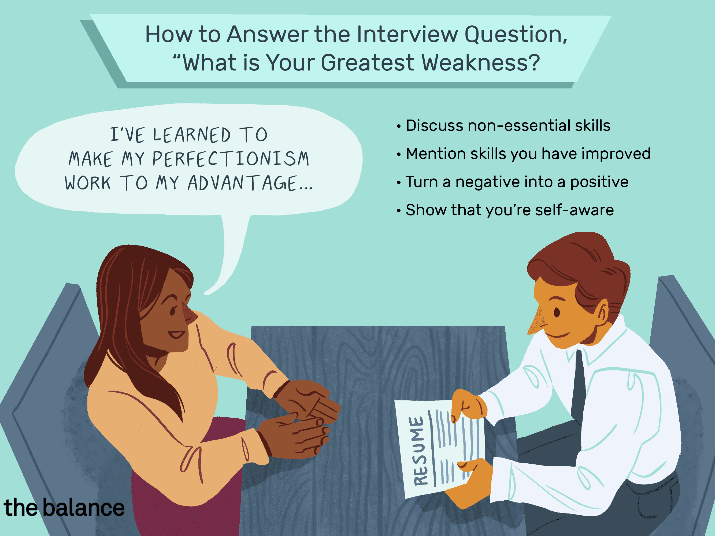
How to identify your Strengths and weaknesses.
Body
My Strengths have caused me to succeed at most of my Jobs. For me , respect and a strong work ethic have gone a long way . My weaknesses have caused a few bumps in the road also . But I know that my strengths have outweighed my weaknesses throughout the years showing up and being on time goes a long way . A good attitude and willingness to learn and try new things is always appreciated .

Slide 3
REFERENCES
www.goals.com
www.goals.com

Slide 4
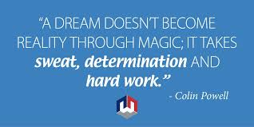
How to identify your strengths and weaknesses
Conclusion
Companies are always looking for people that are willing to take on new responsibilities before a reward , willing to go extra mile . I always try to present Myself that way . My strengths is that I come to work to work , not to get over a man . You can have fun and all that , but texting , Facebook and watching videos while you are supposed to be working is not what I call giving the man fair days work for a fair days wage.

